Slide 1

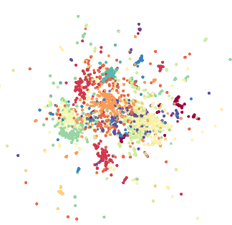
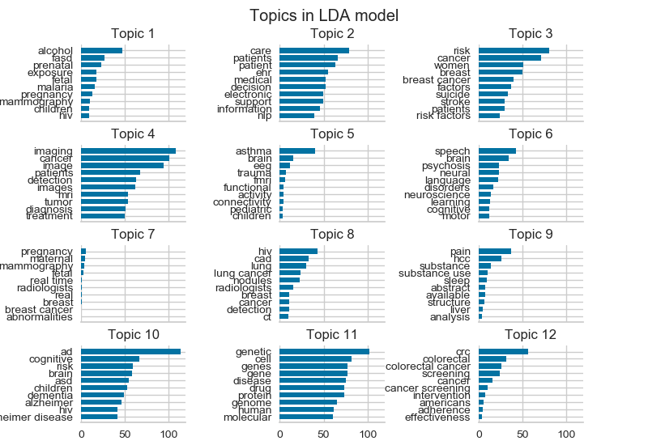

Document Corpus
Feature extraction
Vectorized documents
Concatenation: ”title” + “abstract” + “relevance” = input
Remove stop words
Unigram and bigram extraction
Remove terms with document frequency exceeding 0.5
Term frequency – Inverse document frequency scoring
i = word
j = document
df_{i} = Number of documents containing i
tf_{i,j} = Frequency of i in j
N = total number of documents
‘abnormal’
‘accelerate’
‘accurate’
‘youth’
‘ability’
Document 1
Document 2
Document 3
Document 4
…
Document N
0.071 | 0.435 | 0.092 | 0.079 | … | 0
0 | 0.042 | 0 | 0.081 | … | 0.211
0.049 | 0 | 0.175 | 0.127 | … | 0.014
0.162 | 0.277 | 0 | 0 | … | 0
… | … | … | …
0.381 | 0 | 0 | 0.028 | … | 0
Title
Abstract
Public Health Relevance Statement
$$w_{i,j}={tf}_{i,j} × \log{(\frac{N}{{df}_{i}})}$$
K-Means Clustering
Centroid initialization
Latent Dirichlet Allocation Topic Modeling
Topic 1
Topic 2
Topic 3
Topic 4
Topic 5
Topic 6
Topic 7
Topic 8
Topic 9
Topic 10
Topic 11
Topic 12
Notes:
Figure 1

Slide 2
Document Corpus
Feature extraction
Concatenation: ”title” + “abstract” + “relevance” = input
Remove stop words and perform lemmatization
Unigram and bigram extraction
Remove terms with document frequency exceeding 0.1
Term frequency – Inverse document frequency scoring
i = word
j = document
df_{i} = Number of documents containing i
tf_{i,j} = Frequency of i in j
N = total number of documents
Title
Abstract
Public Health Relevance Statement
$$w_{i,j}={tf}_{i,j} × \log{(\frac{N}{{df}_{i}})}$$
Vectorized documents
‘ability’
‘abnormal’
‘accelerate’
‘accurate’
‘youth’
Document 1
Document 2
Document 3
Document 4
…
Document N
0.071 | 0.435 | 0.092 | 0.079 | … | 0
0 | 0.042 | 0 | 0.081 | … | 0.211
0.049 | 0 | 0.175 | 0.127 | … | 0.014
0.162 | 0.277 | 0 | 0 | … | 0
… | … | … | …
0.381 | 0 | 0 | 0.028 | … | 0
K-Means Clustering
Topic generation
Topic 1
Topic 2
Topic 3
Topic 4
Topic 5
Topic 6
Topic 7
Topic 8
Topic 9
Topic 10
Topic 11
Topic 12
Notes:
Figure 1

